Slide 1

Asteroid Prediction
Jordan Luong
CDS – 492 Final

Slide 2
Project Summary
Objective:
To effectively use 3 machine learning algorithms to predict which Machine Learning Algorithm is best at calculating the Asteroid Diameter. This is using 1of the 2 datasets (named Asteroid_Updated)
This will then be able to run an initial asteroid trajectory prediction, that predicts 4 asteroids’ paths over 100 years
Finally, using the second dataset (named dataset), there will be an asteroid type trajectory prediction, where this prediction will be on each specific asteroid group's trajectory, to see the ecliptic (path)

Slide 3
Technical Review
Used python to develop the scripts to generate the 3 graphs used, as well as 4 different 100-year simulations of the first 4 asteroids in the first data file named ‘Asteroid Updated’
Used parsing techniques as well as math calculations to ensure the results were the correct ones that were to be expected.
Upon deployment, scripts correctly/successfully displayed the 3 predictions that were wanted, though there were challenges in the databases and data frames
Outcomes were to be expected from the goals, three graphs showcasing the correct ideas that were wanted, as well as a 4 section were the 100 year prediction of the asteroids worked as well

Slide 4
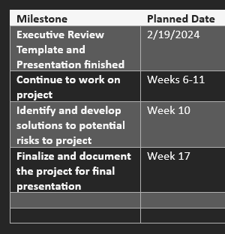
Work Changes and Modifications
New outcome, but still the same topic, affected the initial schedule of tasks to complete
Number of nonvalues in the first dataset
The 5 individual asteroid prediction is just an estimate, instead of being an actual prediction
Problems when running the Machine Learning section for the graph image

Slide 5
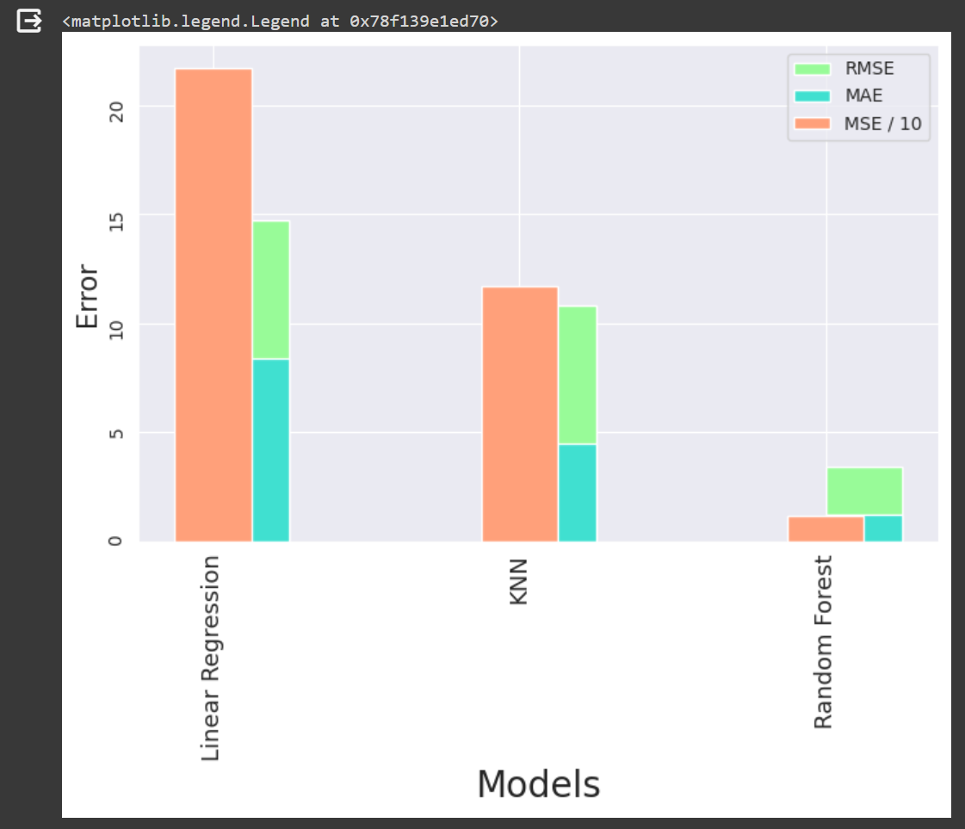
Machine Learning
The 3 machine learning algorithms used in this are;
- Linear Regression, KNN, Random Forest
- This is used to showcase which ML algorithm would fit the best with the dataset

Slide 6
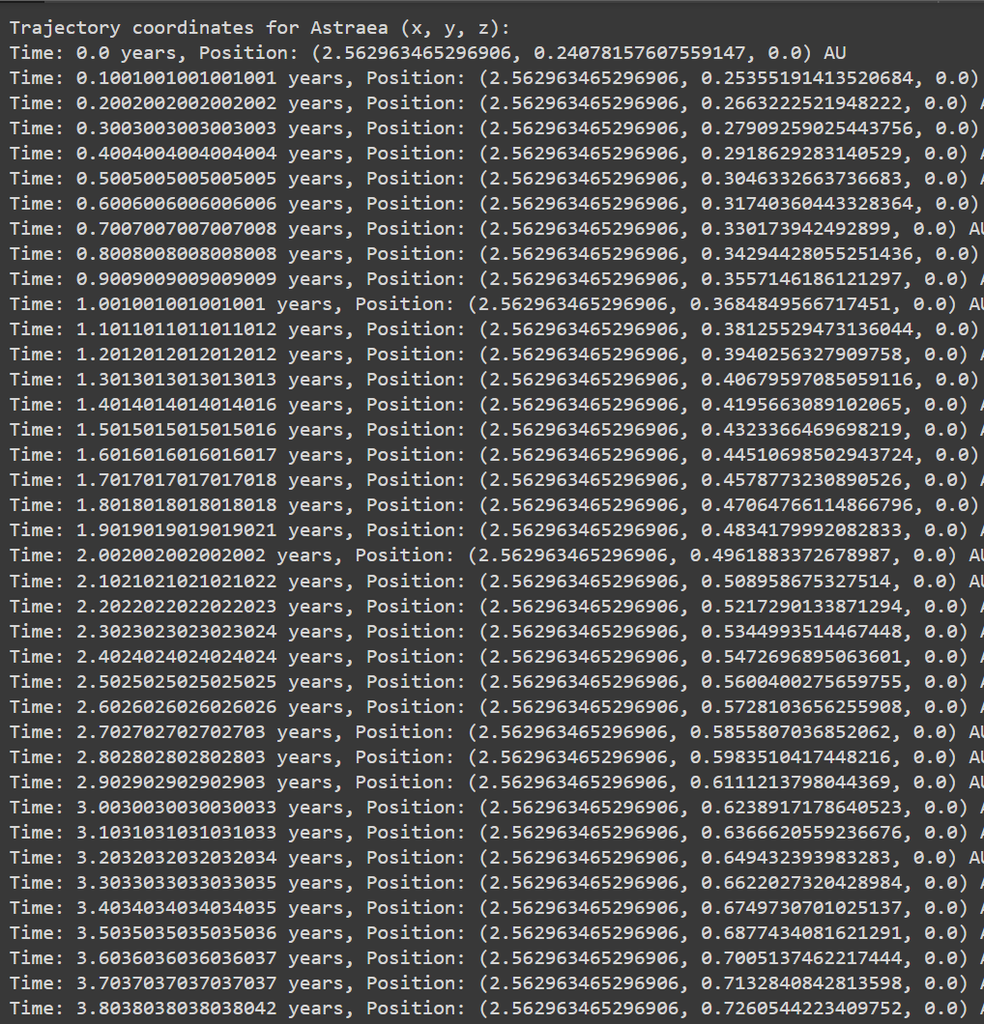
Second Prediction
Shows one 100-year simulation for one asteroid
Used to accurately predict asteroid trajectory
Used for simulation of trajectory
Can be used and auto loaded for all asteroids in data file
Just a test to see if it would work

Slide 7
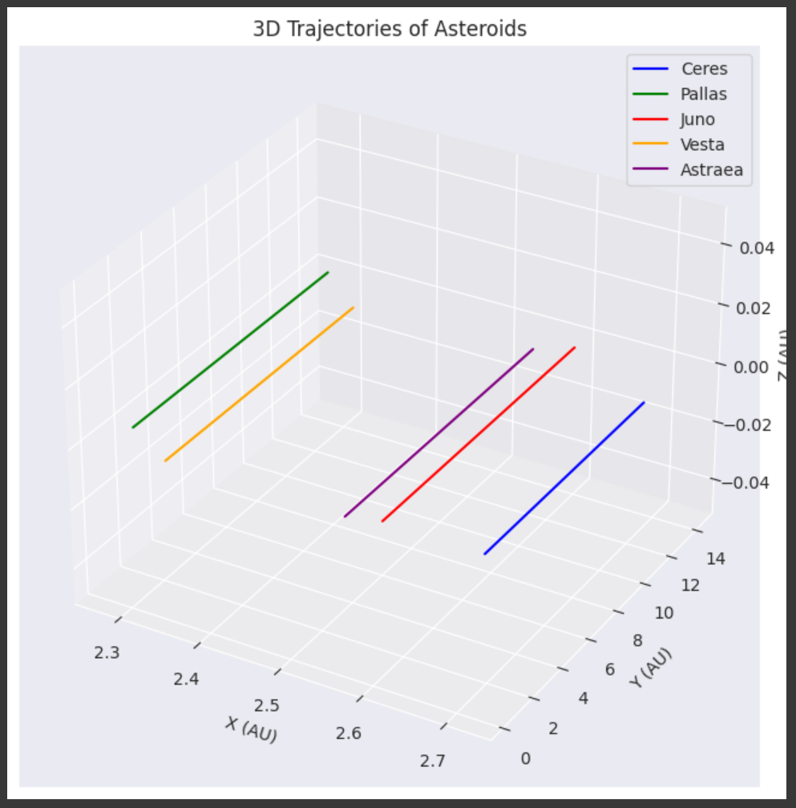
Second Prediction
Going off the first dataset, this is a prediction using the first 5 asteroids in the file to run a prediction of their paths over a simulation of 100 years.
This is a prediction using the first dataset, there isn’t anything in the data that will allow a proper trajectory prediction

Slide 8
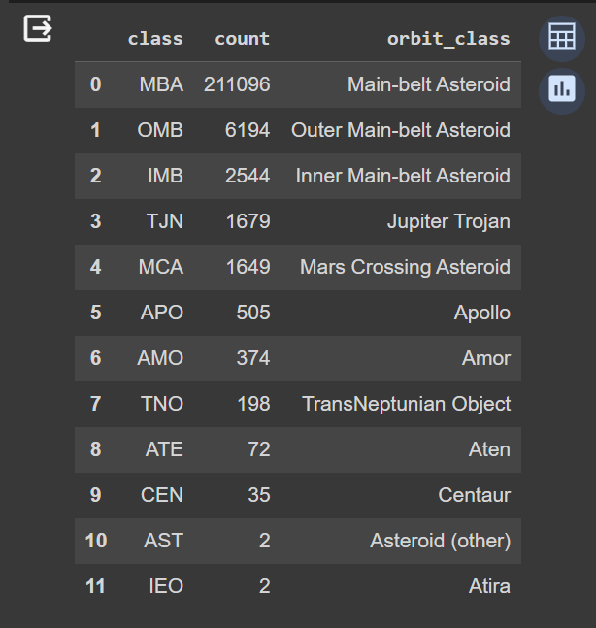
Third Presentation
This graph is showcasing the ecliptic, or path, of the certain groups of asteroids. These groups are based on their orbit, and where they are located.
This table showcases the names of the class of the asteroids, as well as the count, and finally the orbit class

Slide 9
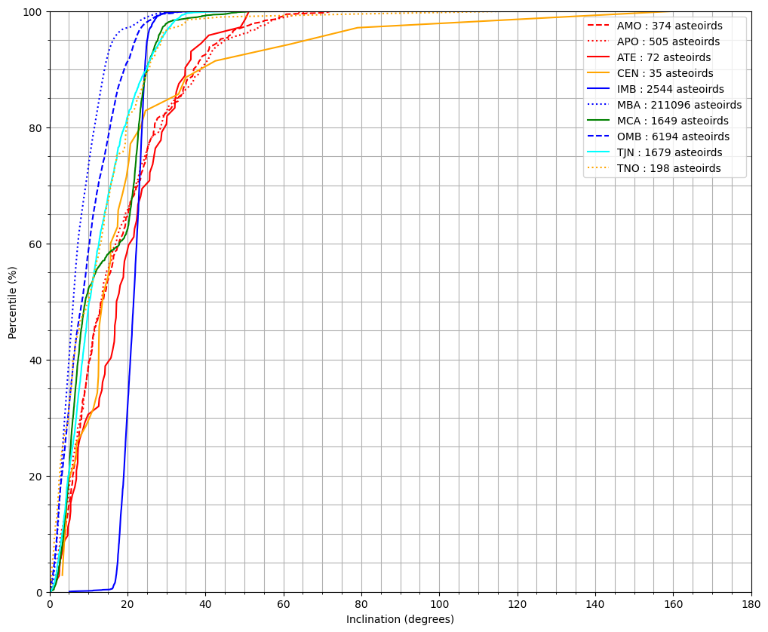
Third Presentation
This graph is showcasing the ecliptic, or path, of the certain groups of asteroids. These groups are based on their orbit, and where they are located.

Slide 10
Project
The overall course of the project was complete, apart from the individual asteroid trajectory prediction, lack of data that is needed is stopping this here
Goal was to discover which ML algo was best at predicting Diameter, found to be Random Forrest
The other 2 predictions were addons, that will eventually lead to the idea behind the project, individual asteroid trajectory, used for impact and simulation

Slide 11
Challenges
There was a lot of missing data values in the first prediction dataset
Finding the correct data to use for these predictions an models
Future additions: limited access to individual trajectory and other necessary data

Slide 12
Future
Future goal is to be able to predict individual asteroid trajectory
This would then be used to predict and calculate asteroid impact
Would allow for better preparation and provide a timetable for asteroid impact

